Slide 1
Notes App By Raghvendra
This app is made for making notes according to our requirement and notes can be modified.

Slide 2
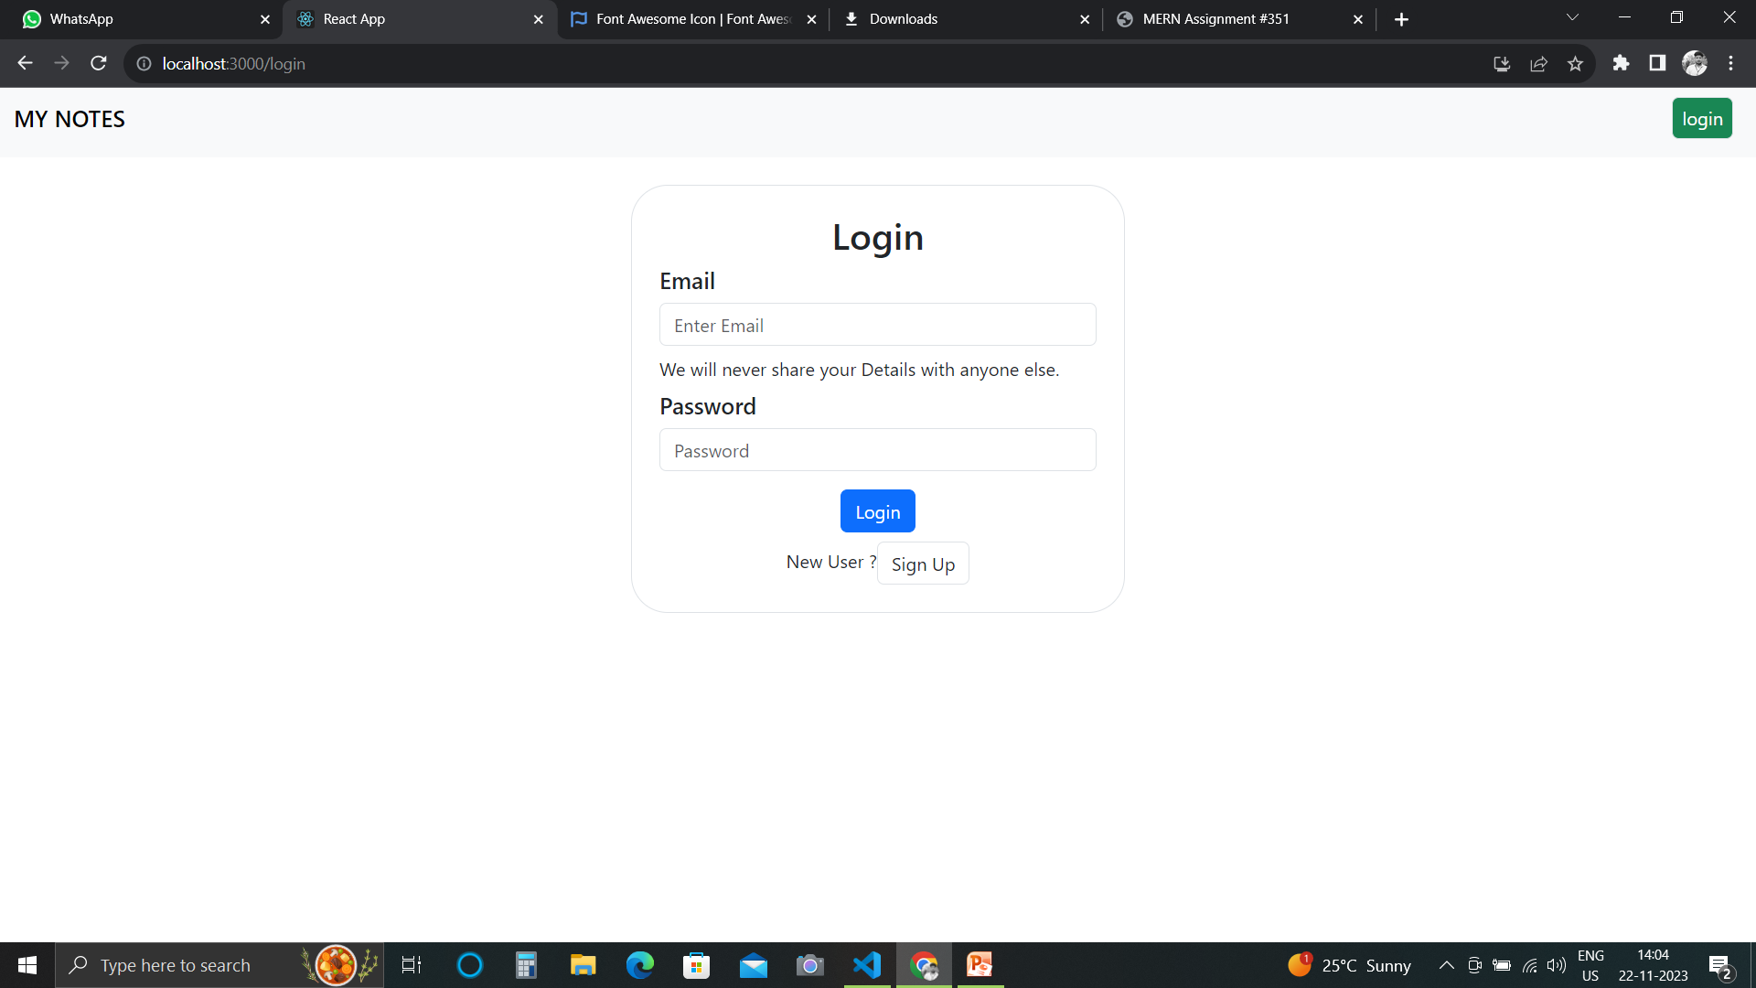
Login Page

Slide 3
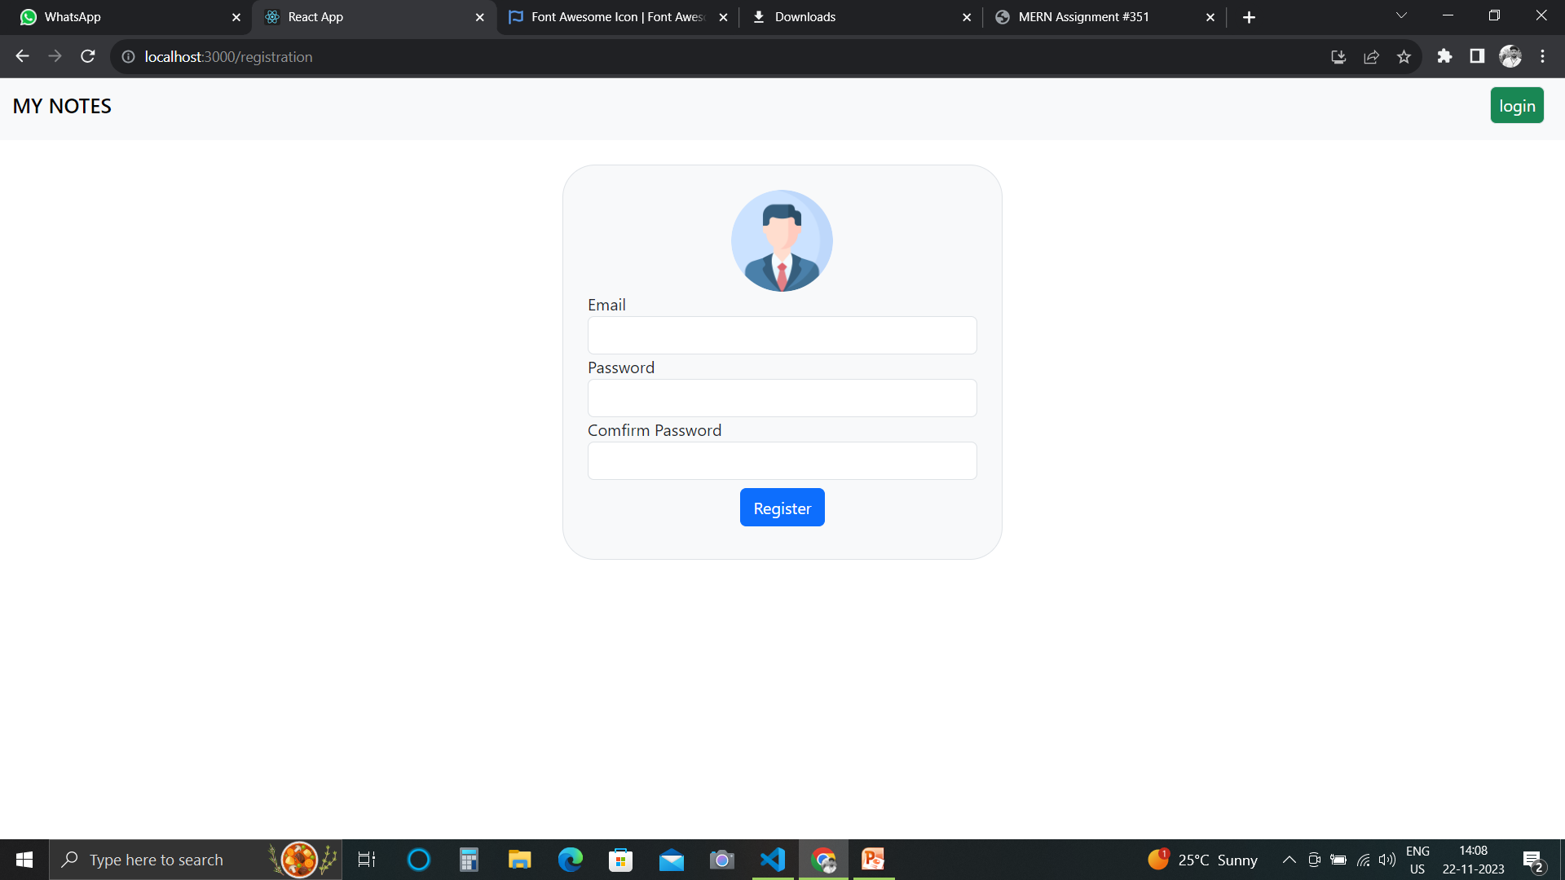
Registration Page

Slide 4
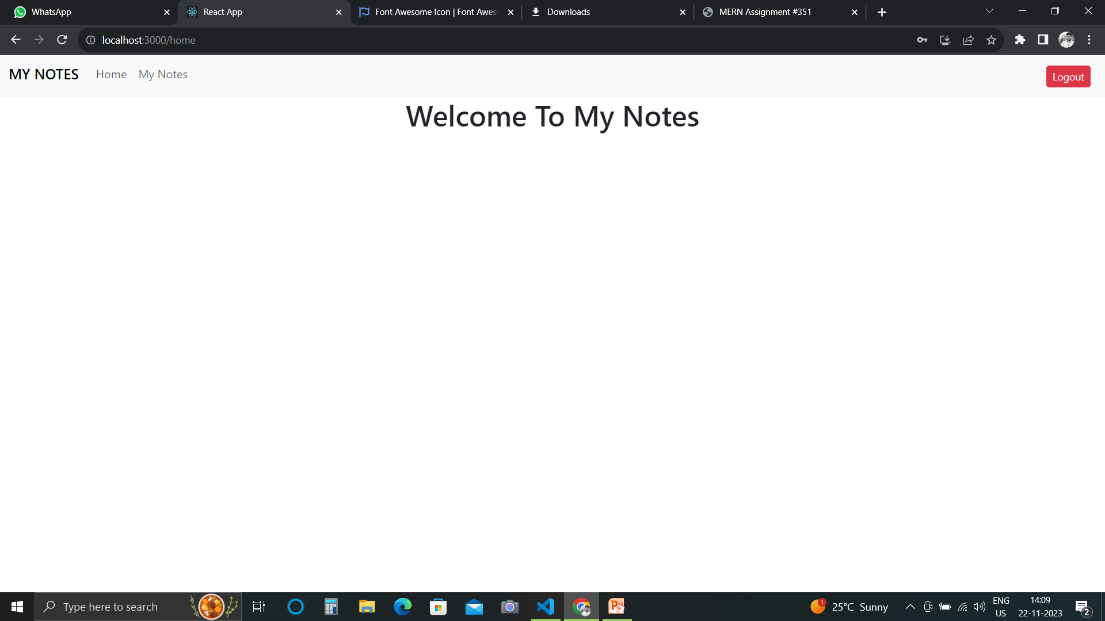
Home Page

Slide 5
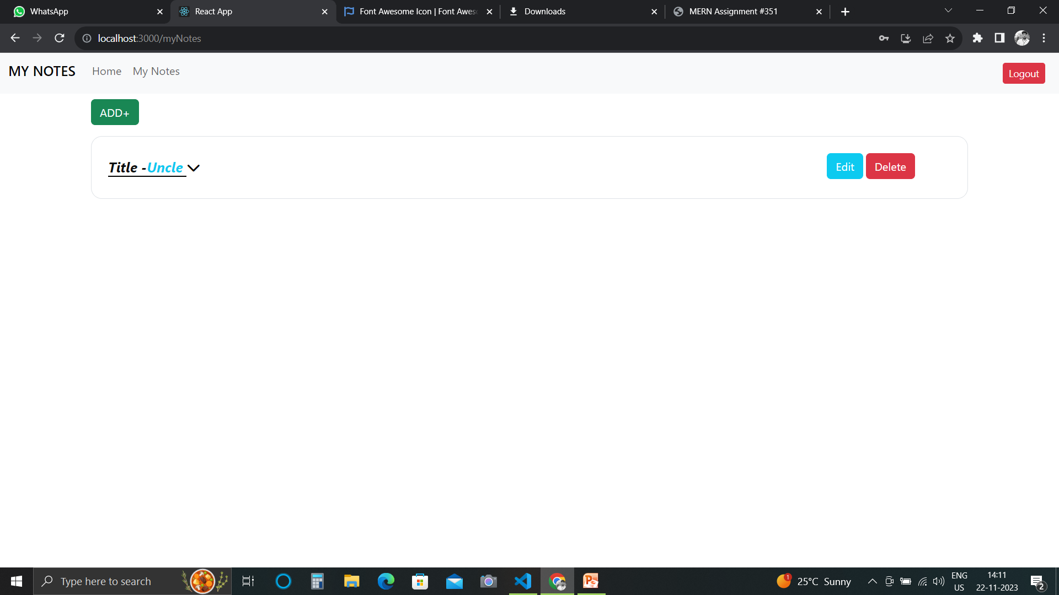
Notes Page

